Slide 1
Connectionist Computing
COMP 30230/41390
Gianluca Pollastri
office: CASL, ground floor Science East.
email: gianluca.pollastri@ucd.ie
Connectionist Computing COMP 30230

Slide 2



Credits
Geoffrey Hinton, University of Toronto.
  borrowed some of his slides for “Neural Networks” and “Computation in Neural Networks” courses.
Ronan Reilly, NUI Maynooth.
  slides from his CS4018.
Paolo Frasconi, University of Florence.
  slides from tutorial on Machine Learning for structured domains.
Connectionist Computing COMP 30230

Slide 3
Lecture notes on Moodle
https://csmoodle.ucd.ie/moodle/course/view.php?id=288
Strictly confidential...
Enrolment key: 30230cc
Connectionist Computing COMP 30230

Slide 4
Books
No book covers large fractions of this course.
Parts of chapters 4, 6, (7), 13 of Tom Mitchell’s “Machine Learning”
Parts of chapter V of Mackay’s “Information Theory, Inference, and Learning Algorithms”, available online at:
http://www.inference.phy.cam.ac.uk/mackay/itprnn/book.html
Chapter 20 of Russell and Norvig’s “Artificial Intelligence: A Modern Approach”, also available at:
http://aima.cs.berkeley.edu/newchap20.pdf
More materials later..
Connectionist Computing COMP 30230

Slide 5
Marking
3 landmark papers to read, and submit a 10-line summary on Moodle about: each worth 6.67%
a small connectionist tool to build and play with: 30%
Final exam: 50%
Connectionist Computing COMP 30230

Slide 6
Programming assignment
Implement a Multi-Layer Perceptron, test it.
The description on Moodle.
Submit through Moodle code and test results by April the 28th at 23:59, any time zone of your choice (Baker Island?).
30% of the overall mark
One third of a grade down every day late, that is: if you deserve an A and you’re 1 day late you get an A-, 2 days late a B+, etc.
Connectionist Computing COMP 30230

Slide 7
Assignment 2
Read the paper “Finding structure in time”, by Elman (1990), up to and excluding the Discovering the notion "word" section.
The paper is on Moodle.
Submit a 250 word MAX summary by April the 4th at 23:59 on Moodle, any time zone of your choice (Baker Island?).
5% of the overall mark
1/3 of a grade down every day late, that is: if you deserve an A and you’re 1 day late you get an A-, 2 days late a B+, etc.
You are responsible for making sure I get it..
Connectionist Computing COMP 30230

Slide 8
Learning and gradient descent problems
Overfitting (general learning problem): the model memorises the examples very well but generalises poorly.
GD is slow... how can we speed it up?
  GD does not guarantee that the direction of maximum descent points to the minimum.
  Sometimes we would like to run where it’s flat and slow down when it gets too steep. GD does precisely the contrary.
Local minima?
Connectionist Computing COMP 30230

Slide 9
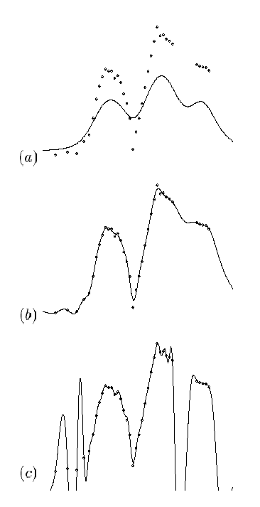
Overfitting
a) can’t fit the examples well enough.
b) looks great.
c) fits all points even better than b) but isn’t the easiest hypothesis.
Connectionist Computing COMP 30230

Slide 10
Ways to prevent overfitting
Use a model that has the right capacity:
  enough to model the true regularities
  not enough to also model the spurious regularities (assuming they are weaker).
  problem: how do we know which regularities are real?
Standard ways to limit the capacity of a neural net:
  Limit the number of hidden units.
  Limit the size of the weights.
  Stop the learning before it has time to overfit.
Connectionist Computing COMP 30230

Slide 11
Limiting the size of the model: using fewer Hidden Units
If n=number of inputs and M=number of hidden units the VC of a MLP is proportional to (n M logM).
Reducing M reduces the capacity of the model -> prevents overfitting.
Of course we need to know the exact capacity we need. Too many weights: overfitting. Too few weights: underfitting.
In practice: trial and error.
Connectionist Computing COMP 30230

Slide 12
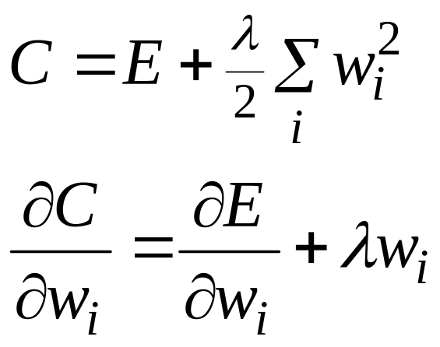
Limiting the size of the model: weight decay
Weight-decay involves adding an extra term to the cost function that penalises the squared weights.
  Keeps weights small unless they have large error derivatives.
Connectionist Computing COMP 30230

Slide 13
Preventing overfitting: early stopping
If we have lots of data and a big model, it’s very expensive to keep re-training it with different amounts of weight decay.
It is much cheaper to start with very small weights and let them grow until the performance in generalisation starts getting worse.
The capacity of the model is limited because the weights have not had time to grow big.
Connectionist Computing COMP 30230

Slide 14
Sets
Divide the total dataset into three subsets:
  Training data is used for learning the parameters of the model.
  Validation data is not used for learning but is used for deciding what type of model and what amount of regularisation works best.
  Test data is used to get a final, unbiased estimate of how well the network works. We expect this estimate to be worse than on the validation data.
We could then re-divide the total dataset to get another (or more than one) unbiased estimate of the true error rate. N-fold Cross-Validation.
Connectionist Computing COMP 30230

Slide 15
Fighting overfitting: combining networks
Averaging the predictions of many different networks is a good way to avoid overfitting. Ensemble, ensembling..
It works best if the networks are as different as possible.
Connectionist Computing COMP 30230

Slide 16
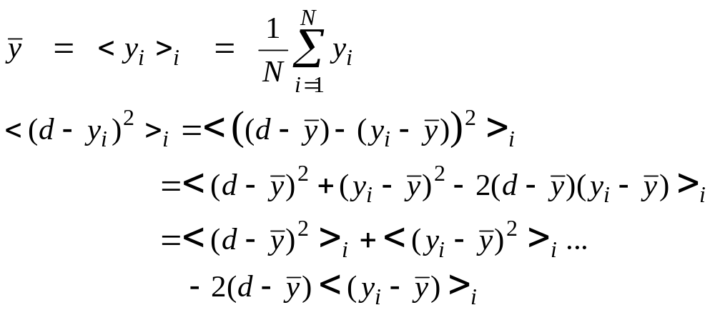
Why combining networks works
We want to compare two expected squared errors
  Method 1: Pick one of the predictors at random
  Method 2: Use the average of the predictors, y
Connectionist Computing COMP 30230

Slide 17
Why combining networks works
The average squared error of the predictors is equal to the squared error of the average of the predictors, plus the average squared difference between a predictor and the average of the predictors.
In conclusion, the squared error of the average of the predictors is always smaller than the average squared error of the single predictors (unless all the predictors are exactly the same).
Connectionist Computing COMP 30230

Slide 18
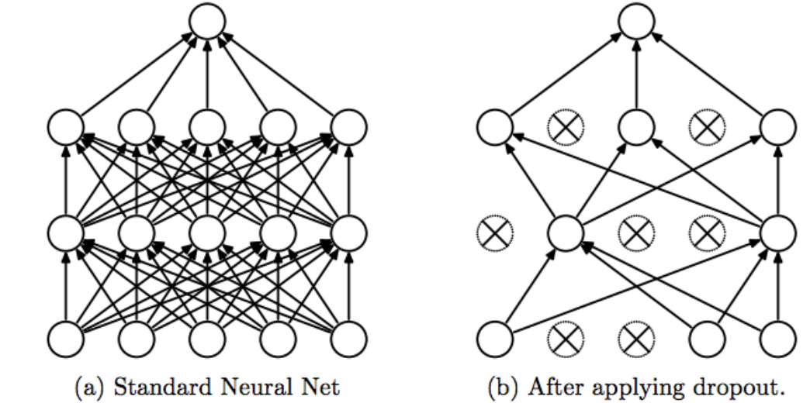
Ensembling with just 1 training: dropout
During training, at each step knock out some (different) randomly chosen connections.
When predicting, use all connections (you need to introduce a normalising constant for this to work correctly).
This is equivalent to having a very large ensemble of networks, but you train only once!

Slide 19
Words of caution on dropout based on my experience
It doesn't always work, and there are preconditions for it to work.
1) When you train with knocked out connections, you effectively have lower net capacity. So you need to have an oversized net to start with, which mitigates the gains of having fewer trainings to run. If your network has the right capacity in the first place, dropout will make it underfit.
2) It does impose fairly strict constraints on what individual weights represent (reducing their cooperation), which reduces effective capacity further.
That said, you typically use this in a subset of the layers. It can be a very convenient technique to avoid complex fine-tuning and model selection: just throw a humongous net at the problem, introduce dropout and wait.
Connectionist Computing COMP 30230

Slide 20
Overfitting: summary
Problem that occurs when the network memorises the examples but not the underlying trends.
It can be prevented by:
  limiting number of weights
  weight decay
  early stopping
  combining networks (especially if they disagree)
Connectionist Computing COMP 30230

Slide 21
Learning and gradient descent problems
Overfitting (general learning problem): the model memorises the examples very well but generalises poorly.
GD is slow... how can we speed it up?
  GD does not guarantee that the direction of maximum descent points to the minimum.
  Sometimes we would like to run where it’s flat and slow down when it gets too steep. GD does precisely the contrary.
Local minima?
Connectionist Computing COMP 30230

Slide 22
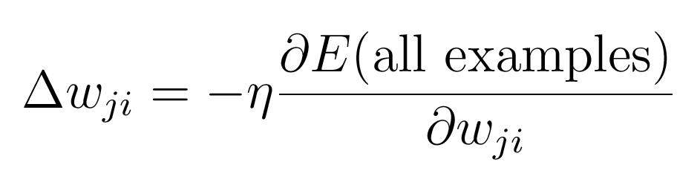
Batch learning
The ideal rule computes one step on the error surface for a whole pass of the training set (epoch). This is called batch learning:
Connectionist Computing COMP 30230

Slide 23
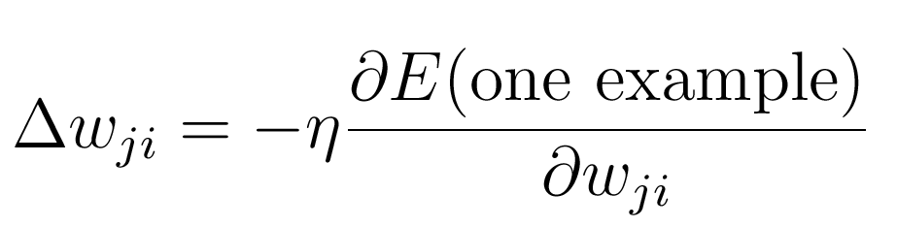
Online learning
An alternative to batch learning is computing the weight update for each example. This is called online learning:
Connectionist Computing COMP 30230

Slide 24
Online versus batch learning
Online learning zig-zags around the direction of steepest descent.
Batch learning does steepest descent on the error surface
w1
w1
w2
Connectionist Computing COMP 30230
w2

Slide 25
Batch and online
Batch learning is theoretically more sound.
Online learning can be a lot faster: one step for each example vs one step for the whole training set.
Intermediate versions are also possible, for instance update after every group of X examples, where X is smaller than the size of the training set.
In practice it depends on the problem, the format of the input, etc. if online learning is applicable. Trial and error..
Connectionist Computing COMP 30230

